Slide 9
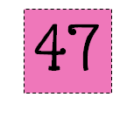

Slide 10
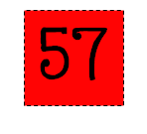
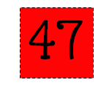

Slide 11
35

Slide 12
47

Slide 13
68

Slide 14
A
A

Slide 16
I
I

Slide 17
O
O

Slide 18
U
U

Slide 22
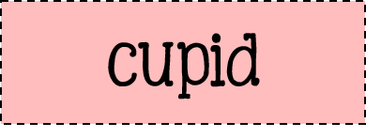
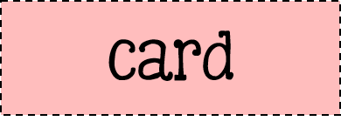

Slide 24
1 | 2 | 3 | 4 | 5 | 6 | 7 | 8 | 9 | 10
11 | 12 | 13 | 14 | 15 | 16 | 17 | 18 | 19 | 20
21 | 22 | 23 | 24 | 25 | 26 | 27 | 28 | 29 | 30
31 | 32 | 33 | 34 | 35 | 36 | 37 | 38 | 39 | 40
41 | 42 | 43 | 44 | 45 | 46 | 47 | 48 | 49 | 50
51 | 52 | 53 | 54 | 55 | 56 | 57 | 58 | 59 | 60
61 | 62 | 63 | 64 | 65 | 66 | 67 | 68 | 69 | 70
71 | 72 | 73 | 74 | 75 | 76 | 77 | 78 | 79 | 80
81 | 82 | 83 | 84 | 85 | 86 | 87 | 88 | 89 | 90
91 | 92 | 93 | 94 | 95 | 96 | 97 | 98 | 99 | 100
101 | 102 | 103 | 104 | 105 | 106 | 107 | 108 | 109 | 110
111 | 112 | 113 | 114 | 115 | 116 | 117 | 118 | 119 | 120

Slide 31
It was recess, on a clod da in February. The clayss was plaing a raging game of hid-and-go-seak. On the jungl gym and in the playhouse, chilren screemed as loud as they could. Hiding kidss weere founde quickly. The geme passed in a blur. None of the plaers were being very snaky, except for Lisa and Krissy. They new just were to hide.
The playgrround slopd towared a hill. A few fete paste the jungle gym, the hil fell sharply down to the football field. Lisa and Krissy were hieding just beond the hill’s lip. No won on the playground could see them. Technically, they where in bounds, but it didn’t feal like they wood ever be found.

Slide 32
Question: Why do we have leap years every 4 years?
Source 1: | URL | Website Publisher or Author
Confirmed by: | URL | Website Publisher or Author
Answer:

Slide 33
Re-type the Valentine with proper language.

Slide 36
4
4
4
4
4
4

Slide 37
4
4
4
4
4
4

Slide 38
4
4
4
4
4
4

Slide 39
https://www.festisite.com/text-layout/valentine-heart/

Slide 40
http://www.readwritethink.org/files/resources/interactives/acrostic/

